Slide 1
MUSCULAR STRENGTH AND MUSCULAR ENDURANCE
Kindergarten-2nd Grade

Slide 2

Muscular Strength
Muscular strength is how strong your muscles are.

Slide 3
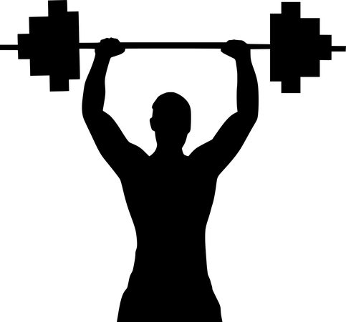
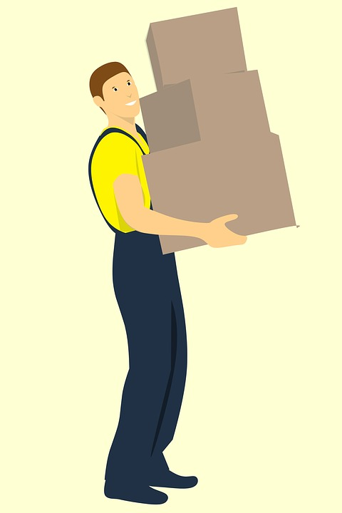
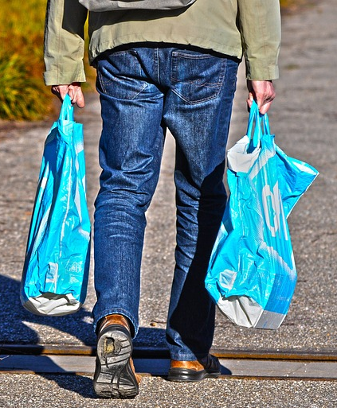
MUSCULAR STRENGTH
Picking up boxes off of the floor.
Lifting a weight one time.
Picking up lots of bags or boxes.

Slide 4
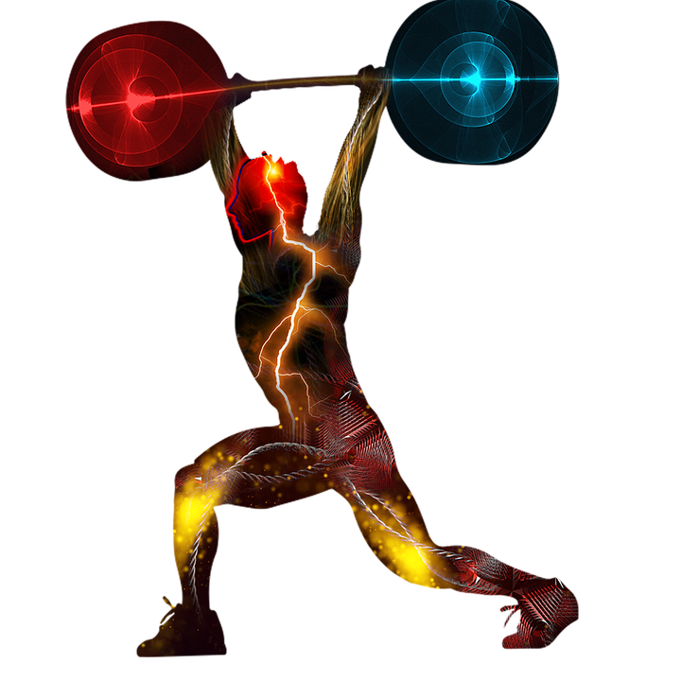
Muscular Endurance
Muscular endurance is how long your muscles can work without getting tired.

Slide 5
MUSCULAR ENDURANCE
How long you can hold the weight above your head.
How far or long someone can carry boxes.
How long or far a person can carry the heavy bags.

Slide 6

QUESTION SECTION
Think carefully about each of the next 3 questions!

Slide 7
1. What is the difference between
“muscular strength” and
“muscular endurance”?
Notes:
Discussion piece

Slide 8
1. What is the difference between
“muscular strength” and
“muscular endurance”?
Muscular Strength = How Much!
Muscular Endurance = How Long!
Notes:
Discussion piece

Slide 9
2. How can you improve your muscular strength and
muscular endurance?

Slide 10
2. How can you improve your muscular strength and
muscular endurance?
EXERCISE

Slide 11
3. What might happen if you have very little muscular strength?

Slide 12
3. What might happen if you have very little muscular strength?
You might be unable to perform your favorite daily activities!

Slide 13
Perform the following exercises and determine which part of your body gets strengthened:
PRACTICE TIME!!!
(shoulders, abdominals, or legs)
Next slide

Slide 14

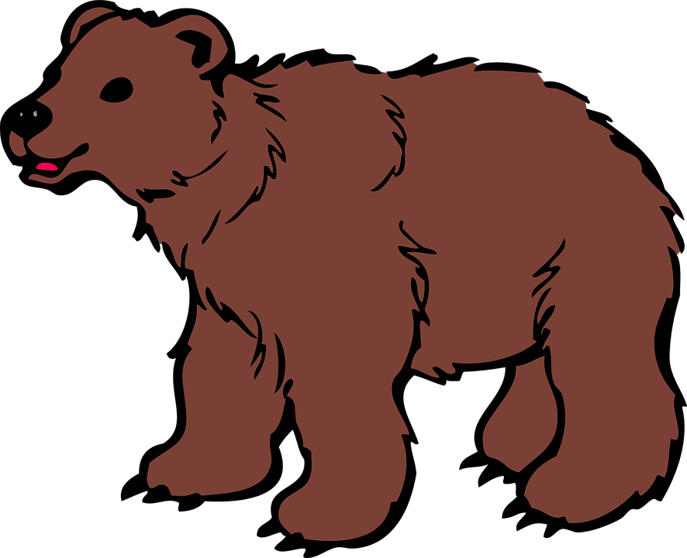
Bear Walk
Which area of the body does the bear walk strengthen?
Move right hand and right foot together
Move left hand and left foot together
Click here
SHOULDERS
SHOULDERS
Only touch the ground with your hands and feet

Slide 15
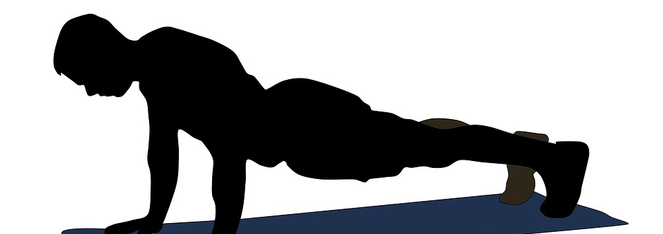
Front Support
Which area of the body does the front support strengthen?
Click here
Straight body
Eyes focus in between hands
Abdominals
Abdominals
Shoulders
Shoulders
Only touch the ground with your forearms and feet

Slide 16
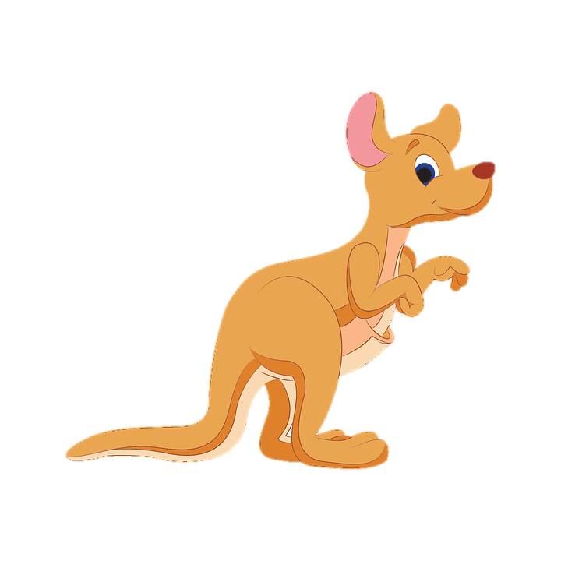
Kangaroo Jump
Which area of the body does the kangaroo jump strengthen?
Click here
Legs
Legs
Squat with knees together
Jump and land with both feet at the same time
Jump forward with hands in front of chest

Slide 17
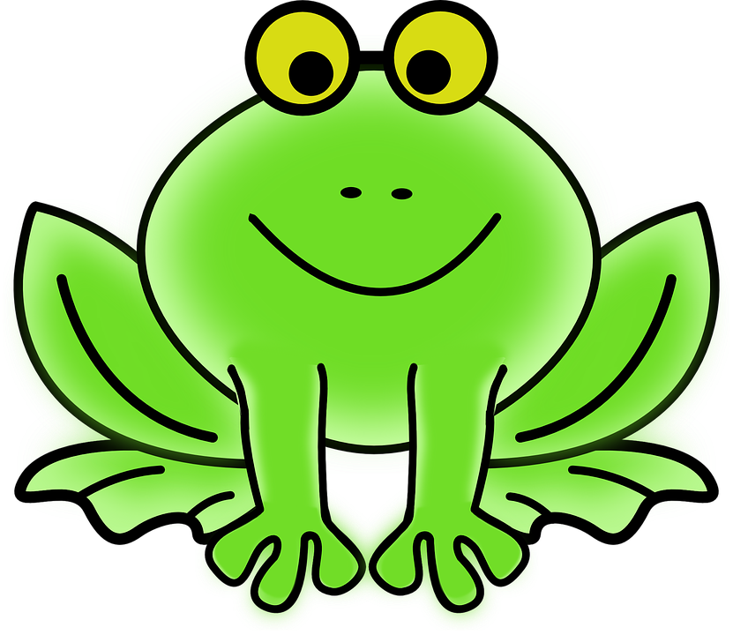
Frog Jump
Which area of the body does the frog jump strengthen?
Click here
Legs
Legs
Squats down
Hands touching the ground in between knees
Jumps and lands on hands and feet

Slide 18
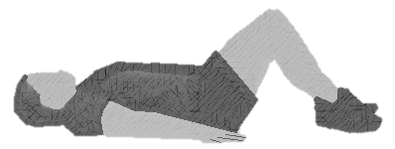
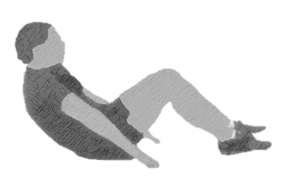
Curl-Ups
Which area of the body do
curl-ups strengthen?
Click here
Abdominals
Abdominals
Straight arms, fingers slide
Head and shoulders come up and off of the mat
Knees bent, heels on the ground
Follow the cadence

Slide 19
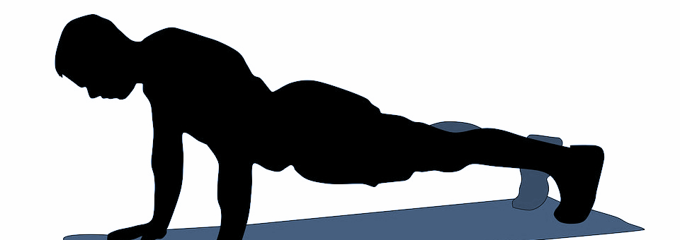
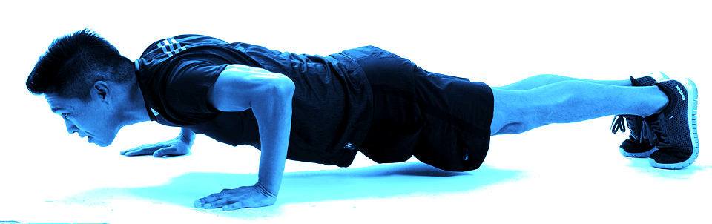
Push-Ups
“UP”
Which area of the body do
push-ups strengthen?
“DOWN”
Click here
Abdominals and shoulders
Abdominals and shoulders
Straight, flat body
90 degree elbows on “down”
Focus eyes between hands
Fingers point forward
Toes curled
Follow the cadence

Slide 20
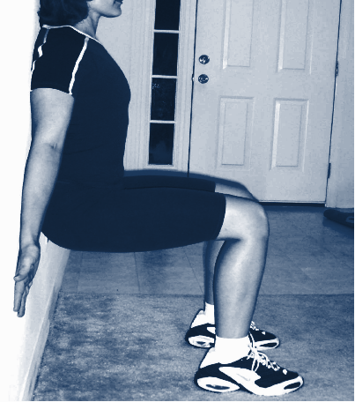

Wall Sit
Which area of the body does
a wall sit strengthen?
Click here
Legs
Legs
Knees and shoulders against wall
Knees bent (90 degrees)
Feet apart
Teacher Note: Last exercise example

Slide 21
DAILY HEALTHY HABITS
This week’s health topic is:
MUSCULAR STRENGTH & MUSCULAR ENDURANCE
What is ONE healthy habit that you can do every day this week to help improve your muscular strength and muscular endurance?

