Slide 1
Istation

Slide 2
What is Istation?
Istation Reading provides computer-based assessment and instruction in reading and writing for PreK-12 students. Students complete game-based lessons and activities led by animated characters while the program generates reports on their progress for teachers, parents and administrators.
Istation (Imagination Station) Reading offers a suite of research-based assessment and instructional tools for targeted instruction and intervention that include:
ISIP ER (Early Reading) and AR (Advanced Reading) - a game-like adaptive reading assessment
Istation Reading - Reading curriculum for grades K-8
Istation Reading en Español - Spanish reading curriculum for bilingual and dual immersion programs in grades K-3
The Istation Reading curriculum offers 400+ hours of instruction and correlates with Texas State Standards.

Slide 3
What is ISIP?
Istation begins with the game-like ISIP (Istation Indicators of Progress) assessment that determines each student’s reading and level and adjusts in length and difficulty in real-time based on student performance.
The program uses assessment data to generate an individualized learning path for reading instruction. Early Readers (grades PreK-3) take the ISIP ER with activities like matching pictures to audio and selecting synonyms from a short list of words.
For advanced readers, activities include choosing a synonym based on context or identifying appropriate words to complete a paragraph of text.
The ISIP AR for advanced readers (grades 4-8) incorporates a space exploration theme throughout the assessment.

Slide 4
The Team☺
Parents
www.istation.com
Students:
This APP can be downloaded from www.istation.com

Slide 5
Downloading Student APP from www.istation.com

Slide 6
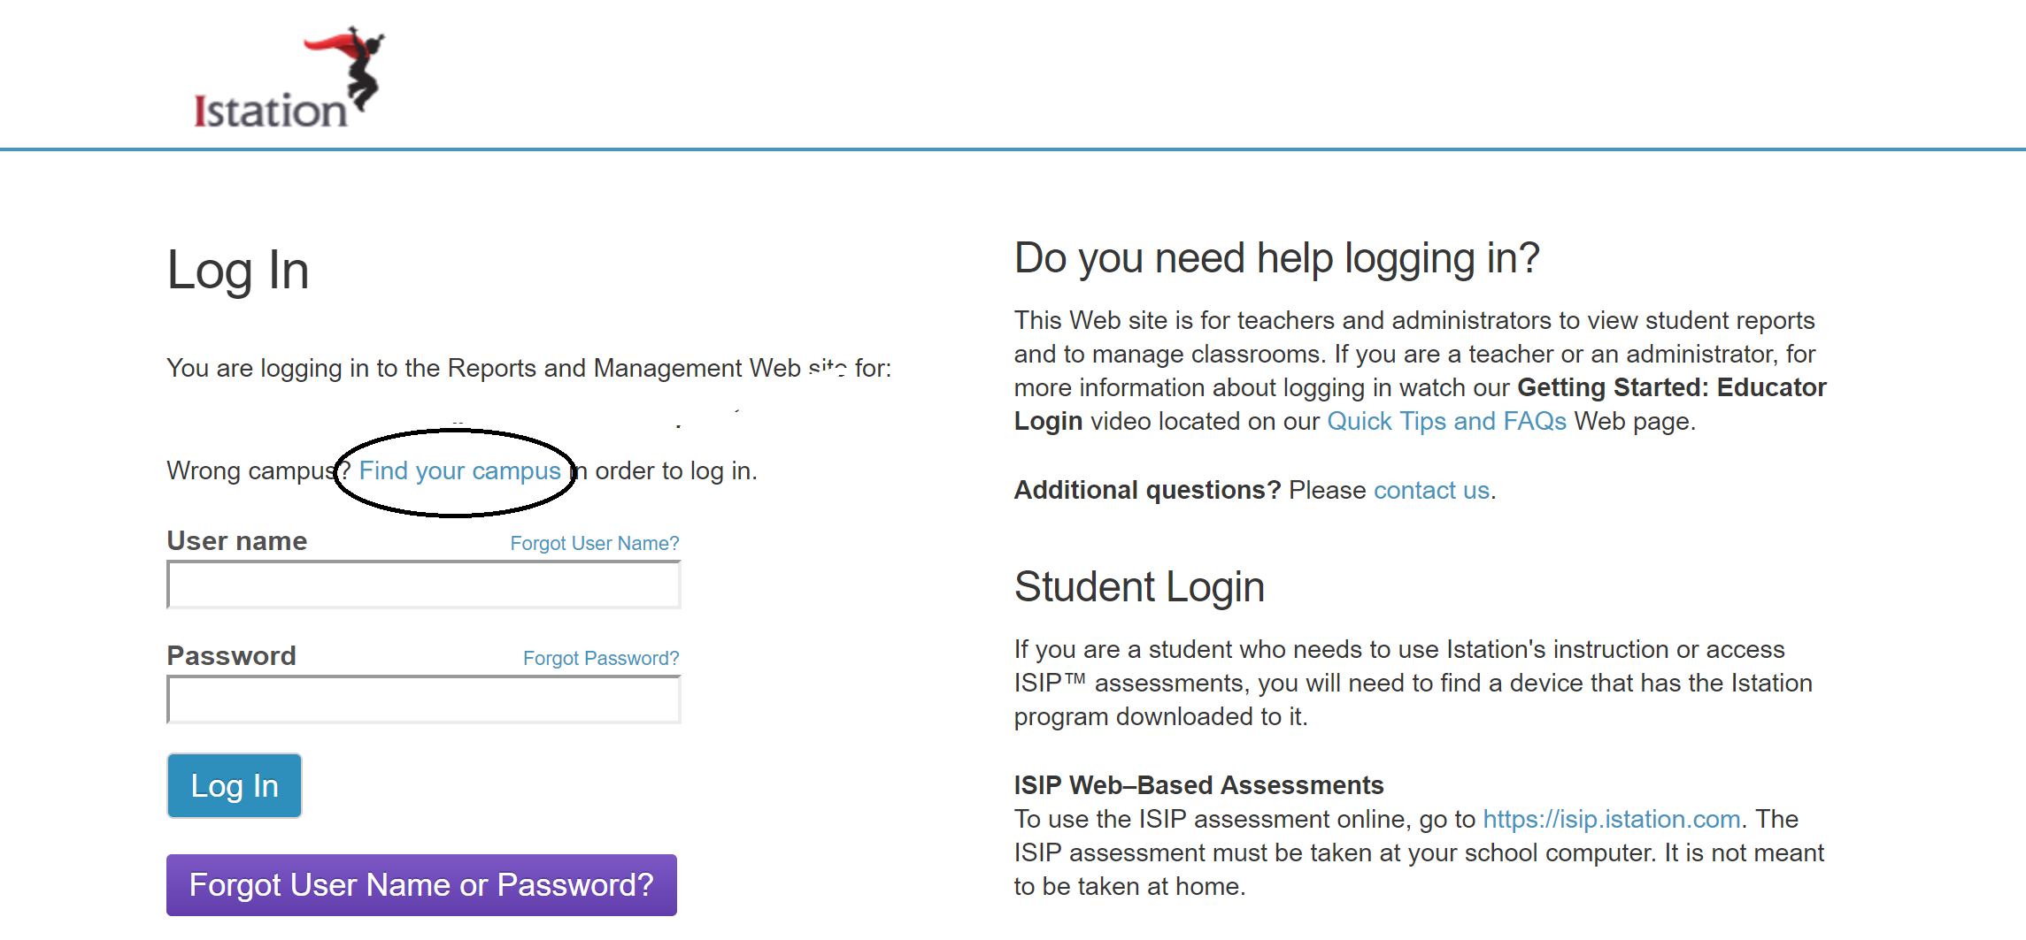
Parents: www.istation.com

Slide 7
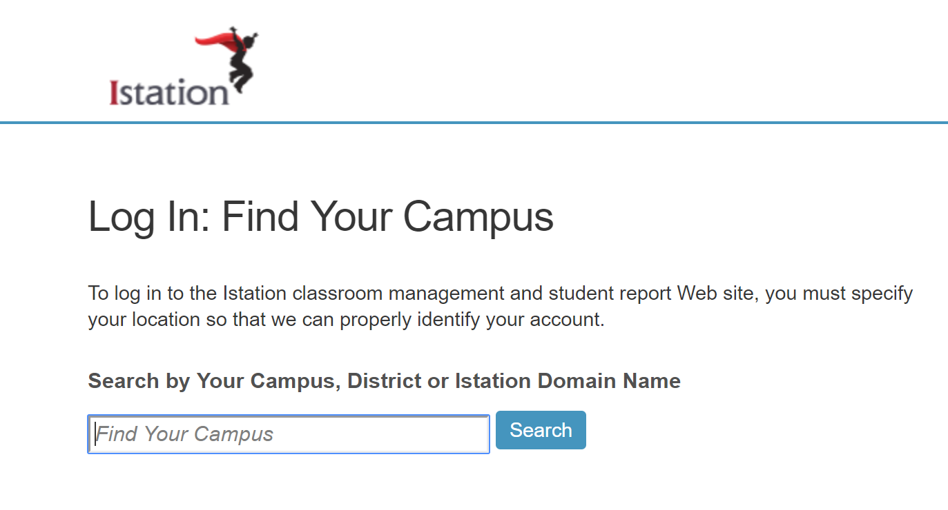

Slide 8
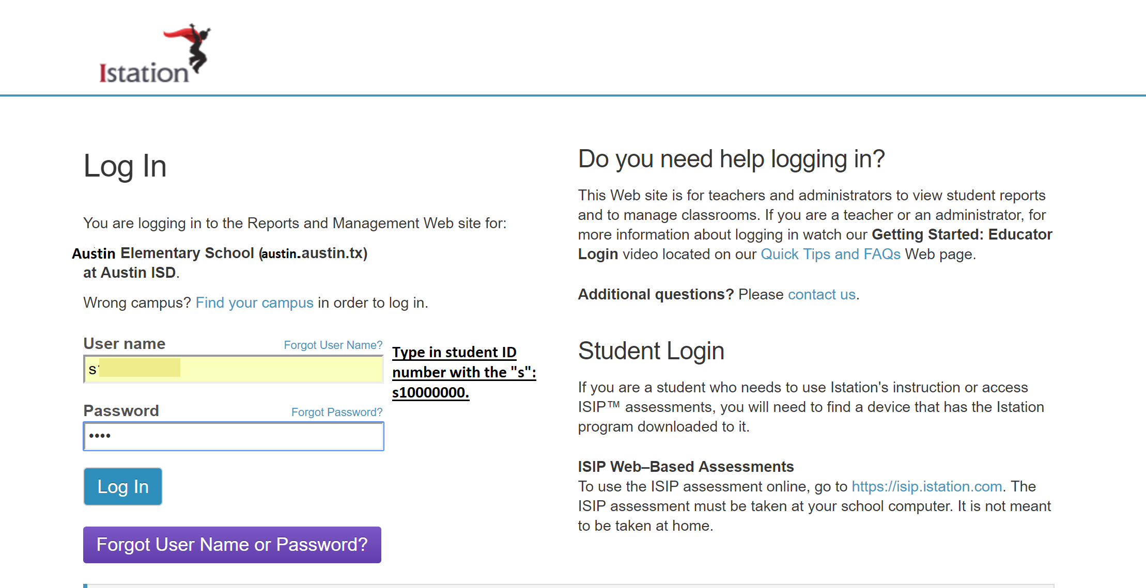
Parents: What you will need
Student ID#
Student Password
If you do not have this information, please contact your student’s teacher at:

Slide 9
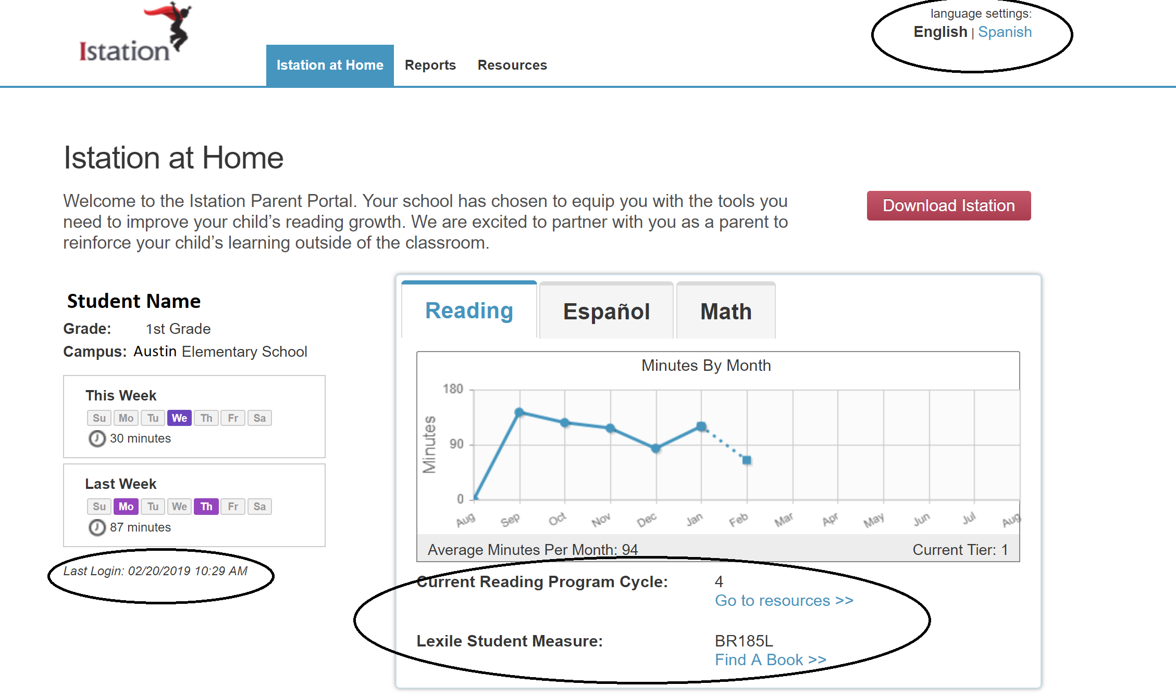

Slide 10
Resources

Slide 11
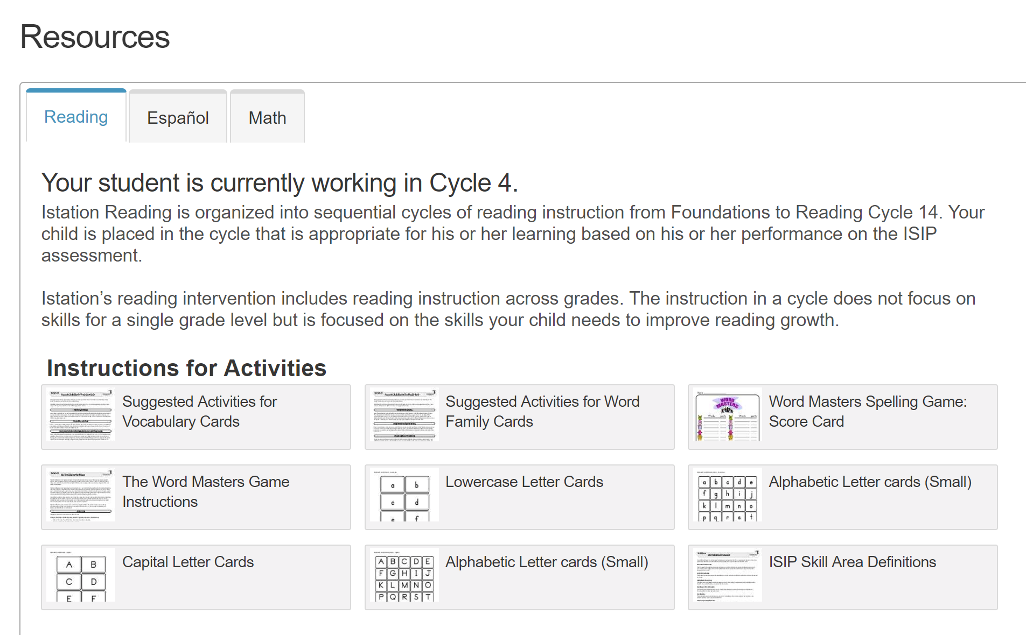

Slide 12
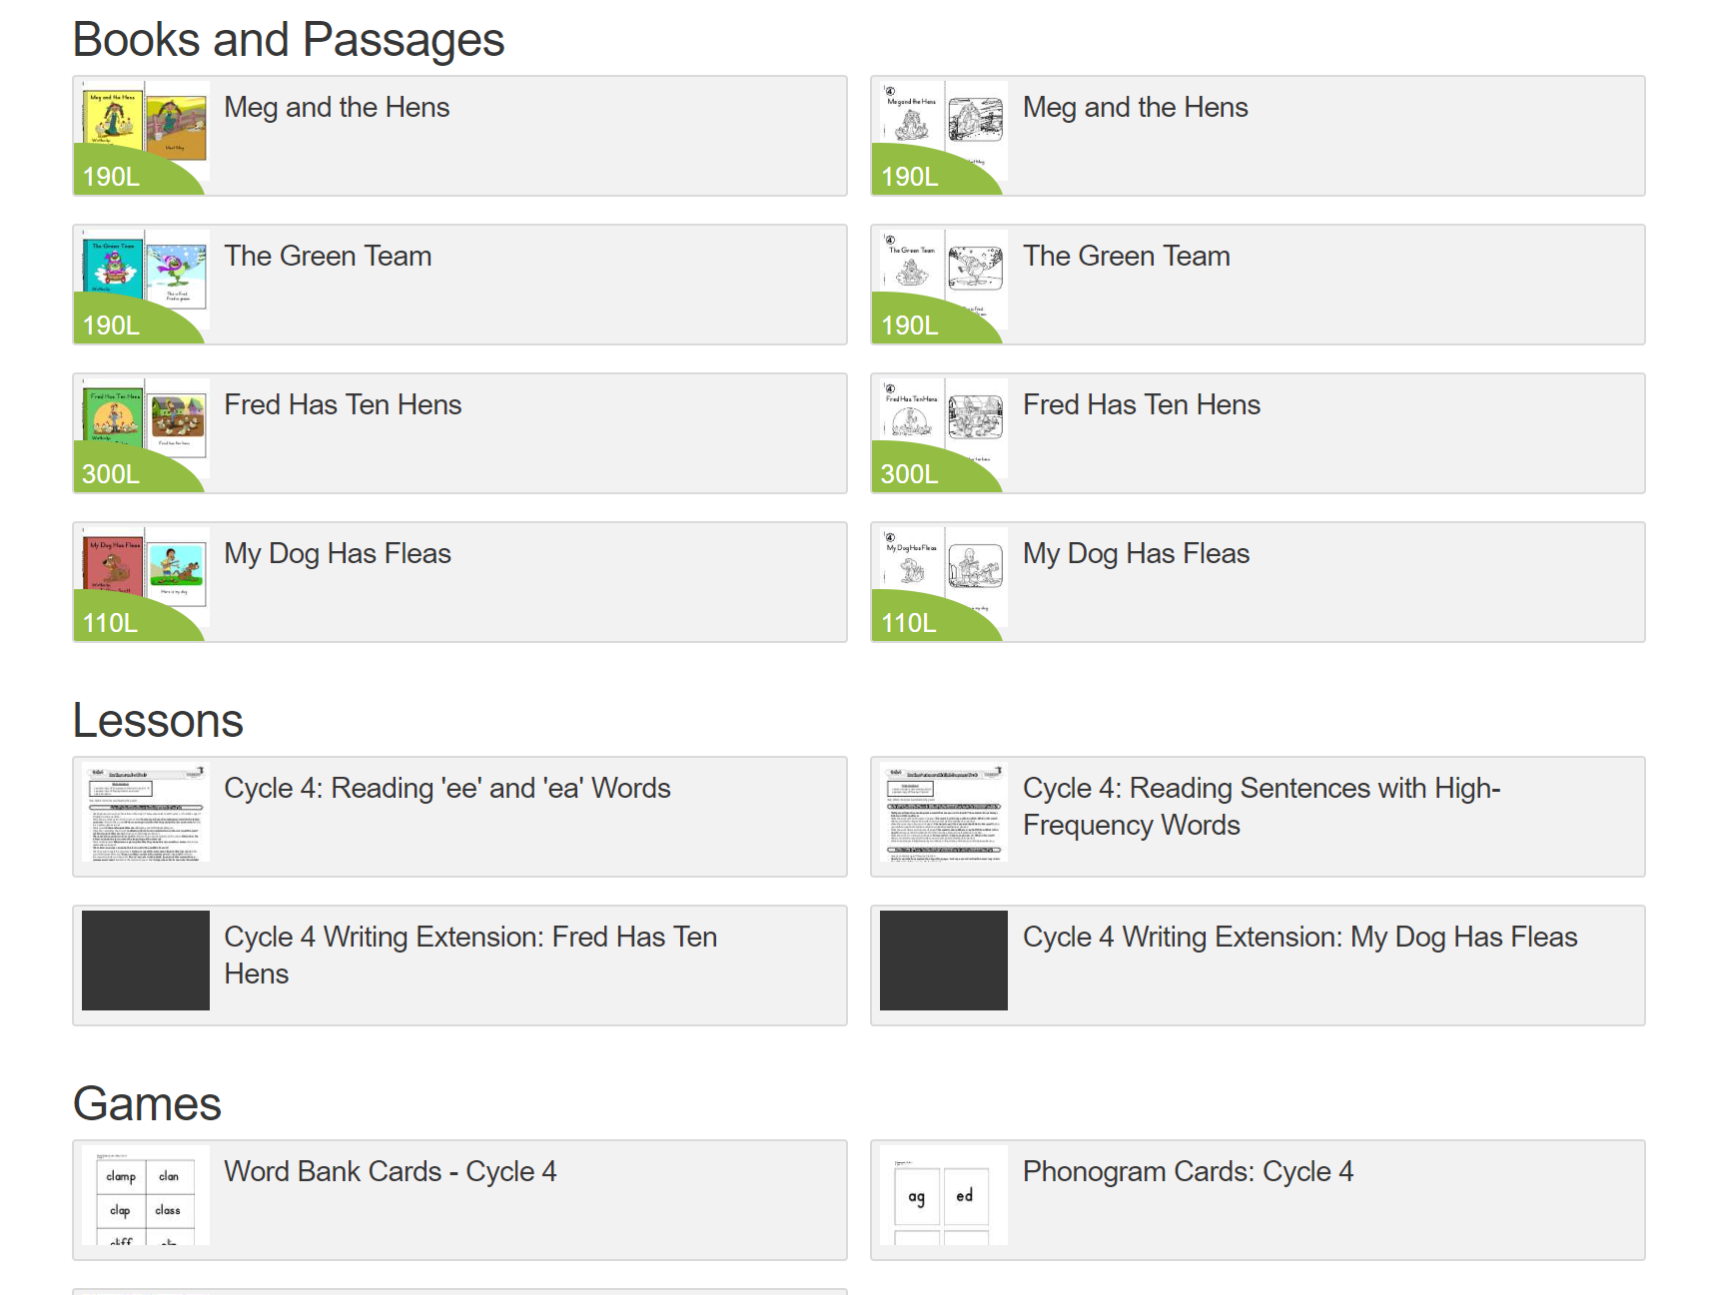

Slide 13
Accessing Student Reports

Slide 14
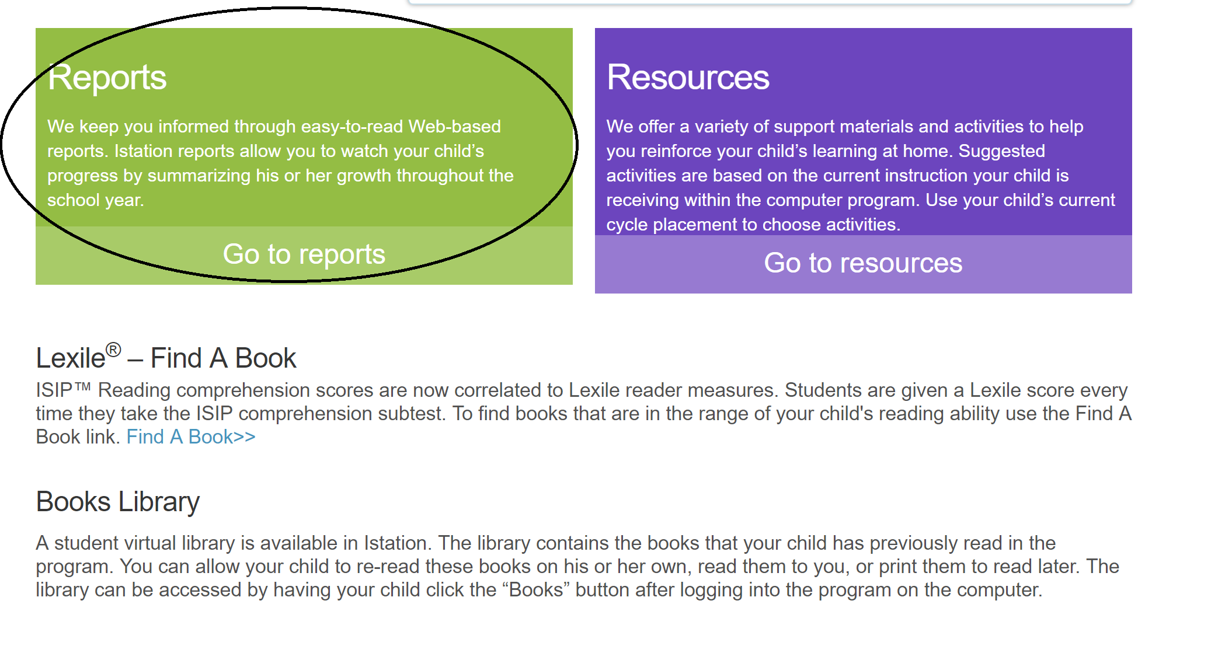

Slide 15
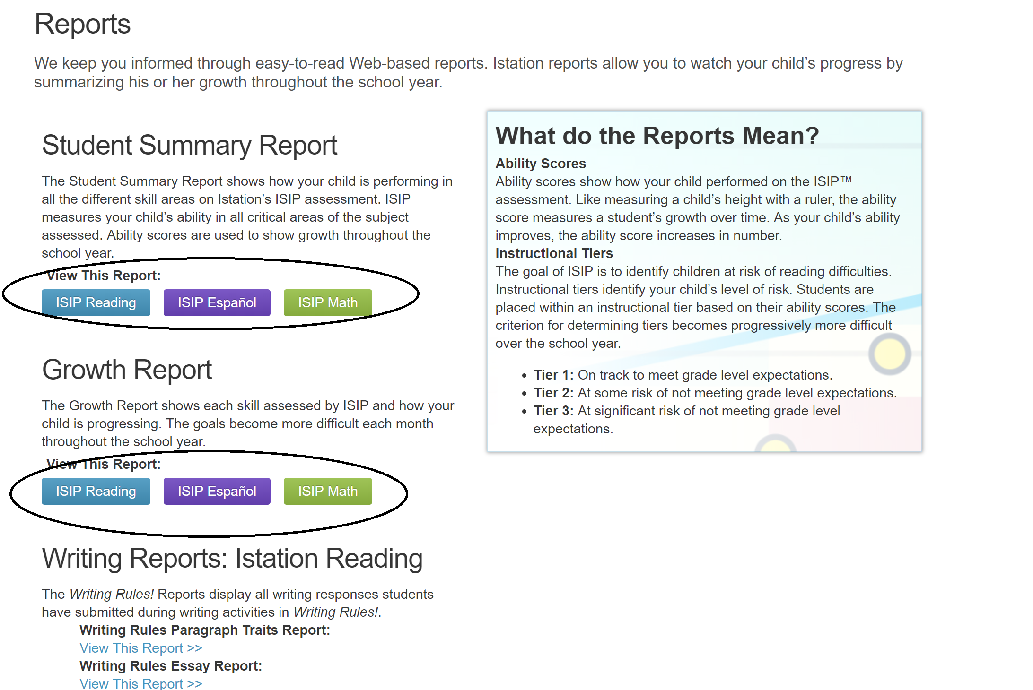

Slide 16
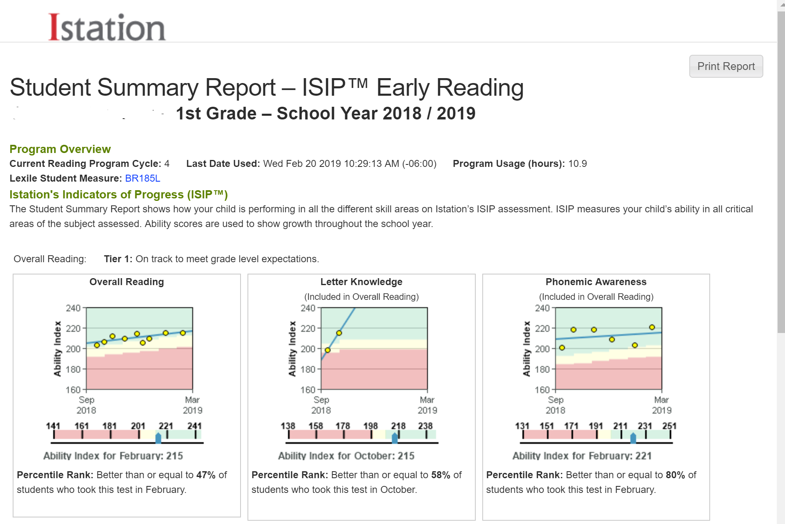

Slide 17
Istation Webinar for Parent
https://register.gotowebinar.com/recording/viewRecording/3689242348032044812/832229553069867522/liana.young@austinisd.org?registrantKey=8805799916766692619&type=ATTENDEEEMAILRECORDINGLINK

